Slide 1
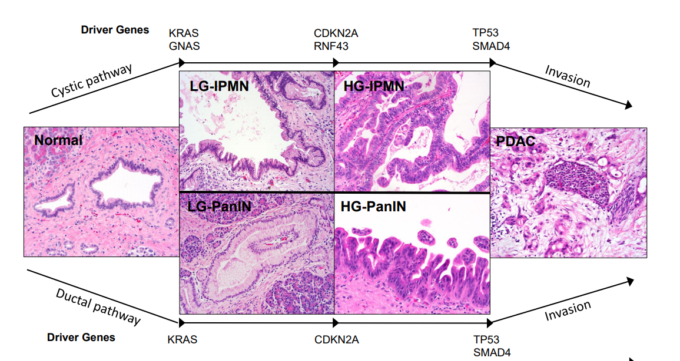
The malignant progression of IPMNs is characterized by an accumulation of somatic driver gene alterations
Felsenstein M. et. al. Gut (2018)
Notes:
From Cathy
The malignant progression of IPMNs from low grade dysplasia to high grade dysplasia is characterized by an accumulation of somatic driver gene alterations. When I say “driver” I mean genes that are frequently mutated in IPMN and seem to confer some growth advantage to these lesions. Years of research has discovered of many of these key driver genes. Several are considered early drivers, meaning they appear early in tumorigenesis, commonly in IPMNs with low grade dysplasia, such as mutations in the genes KRAS and GNAS. While others are late drivers that most often occur in IPMNs with high grade dysplasia, such as p53 and SMAD4. While these drivers have been well characterized, there is currently a lack of knowledge of the genetic heterogeneity that exist within IPMNs with respect to these drivers.

Slide 2
IPMN Progression: Transition from LG dysplasia to HG dysplasia
IPMN is the second most common precancerous lesion of PDAC: around 10% of PDAC is associated with IPMN
High-grade IPMN is an ideal target of detection and intervention
Recent studies showed molecular alterations that are associated with high-grade IPMN/ invasive IPMN
TP53 mutations (Kanda et al.)
A set of molecular alterations (Springer et al.)
Complex karyotype (Duante et al.2016)
Notes:
From Kohei

Slide 3
However, the molecular alterations that are related to IPMN progression are less well understood
What molecular alterations determine histologic progression to HG IPMN?
Clinically, the decision-making of resecting IPMN relies mostly on imaging studies: however clinical diagnosis of HG IPMN often ends up with pathological diagnosis of LG IPMN
Follow up period of IPMN (particularly branch-type IPMN) is controversial
Notes:
From Kohei

Slide 4
Phylogenetic (sample) trees are built by analyzing whether mutations are shared among or private to samples
D (HG)
Private mutations of LG IPMN
A (LG)
C (LG)
Trunk mutations
Private mutations of LG IPMN
B (LG)
Shared mutations
A (LG)
Private mutations of LG IPMN
B (LG)
Shared mutations
C (LG)
Block T1
D (HG)
Private mutations of HG-IPMN
Figures courtesy of Kohei Fujikura

Slide 5
Sample trees do not reflect within sample heterogeneity
Figures courtesy of Kohei Fujikura

Slide 6
Compared to sample trees, clone trees better represent evolutionary relationships of different genetic cell lineages
Notes:
Figure 1. Phylogenetic Analysis of Bulk Tumor Samples. (A) Left panel: clonal composition of a hypothetical primary tumor. Colored circles represent the three clones present (Clones A–C). Mid panel: true clonal sequences for five different genomic sites, where the dashed square indicates a somatic mutation. Right panel: true clonal history with red dots depicting the chronological order of mutations. Tumor most recent common ancestor (MRCA) highlighted as an internal node. (B) Left panel: bulk regional samples (I–III), with intermixed clones at different proportions. Mid panel: mutational profile (presence/absence) inferred, dashed square indicates presence of mutation. Right panel: inferred sample history using maximum parsimony. Red dots depicting the chronological order of mutations. (C) Left panel: bulk regional samples (I–III), with intermixed clones at different proportions. Mid panel: variant allele frequency (VAF) estimates for mutation at each sample, and inferred clonal sequences using the Clomial algorithm [14]. Right panel: inferred clonal history using maximum parsimony. Red dots depicting the chronological order of mutations.

Slide 7
Undetermined nature of evolutionary reconstruction leads to multiple possible clone trees with differing topologies
Partial order plot
Jiao et al. 2014

Slide 8
Undetermined nature of evolutionary reconstruction leads to multiple possible clone trees with differing topologies
Aguse et al. 2019

Slide 9
How can we construct and summarize clone trees in a way that is readily interpretable?
Considerations:
High uncertainty of clonal relationships for mutations with lower cellular prevalence
Different tree topologies may have different biological implications
Proposed solution:
Leverage the presence/absence of mutations in each sample to create a crude tree structure, which will serve as a basis of the resulting clone trees

Slide 10
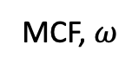
Simulated data: 100 variants total, 10 per cluster
MCF, $ω$
Root
k | S1 | S2 | S3
1 | 0.98 | 0.99 | 0.97
2 | 0.98 | 0.90 | 0.82
3 | 0.55 | 0.00 | 0.80
4 | 0.20 | 0.00 | 0.50
5 | 0.30 | 0.00 | 0.30
6 | 0.43 | 0.90 | 0.00
7 | 0.30 | 0.70 | 0.00
8 | 0.20 | 0.00 | 0.00
9 | 0.00 | 0.00 | 0.30
10 | 0.00 | 0.50 | 0.00
S1, S2, S3
1
2
S1, S3
S1, S2
3
6
4
5
7
S1
S3
S2
8
9
10

Slide 11
Scheme for constructing clone trees
Cluster mutations
Build trees starting from crude structure

Slide 12
Clustering first – z results
S1, S2, S3
1
2
S1, S3
S1, S2
3
6
4
5
7
S1
S2
S3
8
9
10
Simulated data: 100 variants total, 10 per cluster

Slide 13
Model estimates of mutant cell fractions (ω) correspond well with true values

Slide 14
Crude tree structure based on sample presence
Root
Level 3:
Present in 3 samples
S1, S2, S3
Level 2:
Present in 2 samples
S1, S2
S1, S3
S2, S3
Level 1:
Present in 1 sample
S1
S2
S1
S3
S2
S3

Slide 15
Crude tree structure based on sample presence
Root
ω
Level 3:
Present in 3 samples
S1, S2, S3
Level 2:
Present in 2 samples
S1, S2
S1, S3
S2, S3
Level 1:
Present in 1 sample
S1
S2
S1
S3
S2
S3
Present in sample if ω > 0.01

Slide 16
Crude tree structure based on sample presence
Root
ω
Level 3:
Present in 3 samples
S1, S2, S3
Level 2:
Present in 2 samples
S1, S2
S1, S3
S2, S3
Level 1:
Present in 1 sample
S1
S2
S1
S3
S2
S3
Present in sample if ω > 0.01

Slide 17
Crude tree structure places restraints on possible adjacency matrices
To
ω
 | 1 | 2 | 3 | 4 | 5 | 6 | 7 | 8 | 9 | 10
Root
1
2
3 | - | - |  |  |  | - | - |  |  | -
4 | - | - |  |  |  | - | - |  |  | -
5 | - | - |  |  |  | - | - |  |  | -
6 | - | - | - | - | - |  |  |  | -
7 | - | - | - | - | - |  |  |  | -
8 | - | - | - | - | - | - | - |  | - | -
9 | - | - | - | - | - | - | - | - |  | -
10 | - | - | - | - | - | - | - | - | -
From
Restraints:
Can’t go to self
No restraints if present in same set of samples
Restraint if # of from.samples < # of to.samples
Restraint if to.samples is not subset of from.samples

Slide 18
Tree scoring in SCHISM
$$i$$
$$j$$
$$k$$
$$Z\left(T\right)=TC\left(T\right)+MC(T)$$
Tree
fitness
Topology
cost
Mass
cost
Lineage precedence
rule: $C_{i}≥C_{j}$, $C_{i}≥C_{k}$
Violations of lineage precedence
Violations of lineage divergence
Lineage divergence
rule: $C_{i} ≥ C_{j}+ C_{k}$

